Slide 1

INSTITUTE - UIE
DEPARTMENT- ACADEMIC UNIT-1
Bachelor of Engineering (Computer Science & Engineering)
Subject Name and Code: Object-oriented Programming using C++
CST-157
Prepared by Ms. Jasleen Kaur
Fundamentals of C++
DISCOVER . LEARN . EMPOWER

Slide 2

CHAPTER -1
Course Outcome
CO Number | Title | Level
CO1 | provide the environment that allows students to understand object-oriented programming Concepts. | Remember
CO2 | demonstrate basic experimental skills for differentiating between object-oriented and procedural programming paradigms and the advantages of object-oriented programs. | Understand
CO3 | Ability to demonstrate their coding skill on complex programming concepts and use it for generating solutions for engineering and mathematical problems. | Understand
CO4 | Students will develop skills to design the application of classes, objects, constructors, destructors, inheritance, operator overloading and polymorphism, pointers, virtual functions, templates, exception handling, file operations and handling | Understand
Will be covered in this lecture

Slide 3
CONTENTS
Features of object-oriented programming,
Difference between object oriented and procedure-oriented programming,
Difference between structure and class,
Data types
Input and output streams (cin, cout),
Introduction to namespace.
Object-oriented programming is a programming paradigm based on the concept of "objects", which can contain data, in the form of fields, and code, in the form of procedures.
A feature of objects is an object's procedures that can access and often modify the data fields of the object with which they are associated. [1]

Slide 4
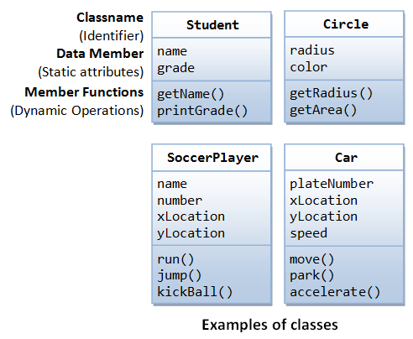
INTRODUCTION
Object-oriented programming – As the name suggests uses objects in programming. Object-oriented programming aims to implement real-world entities like inheritance, hiding, polymorphism, etc in programming.
The main aim of OOP is to bind together the data and the functions that operate on them so that no other part of the code can access this data except that function.
Figure 1.1 Object-oriented programming [1]

Slide 5
C++ is a special-purpose programming language developed by Bjarne Stroustrup at Bell Labs circa 1980.
C++ language is very similar to C language, and it is so compatible with C that it can run 99% of C programs without changing any source of code though C++ is an object-oriented programming language, so it is safer and well-structured programming language than C.

Slide 6
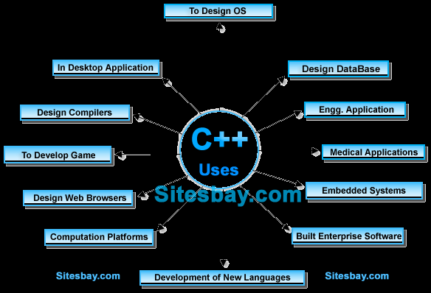

Slide 7
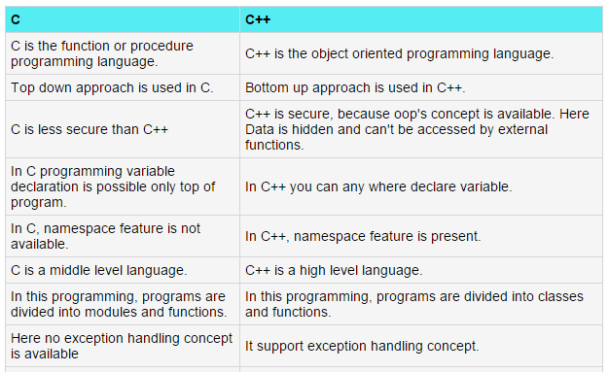

Slide 8
FEATURES OF OOP
CLASS AND OBJECT
ENCAPSULATION
ABSTRACTION and DATA HIDING
POLYMORPHISM
INHERITANCE
DYNAMIC BINDING
MESSAGE PASSING

Slide 9
1.CLASS
CLASS
The building block of C++ that leads to Object-Oriented programming is a Class.
It is a user-defined data type, which holds its own data members and member functions, which can be accessed and used by creating an instance of that class.
A class is like a blueprint for an object.
A Class is a user-defined data-type which has data members and member functions.
Data members are the data variables and member functions are the functions used to manipulate these variables and together these data members and member functions define the properties and behaviour of the objects in a Class.

Slide 10
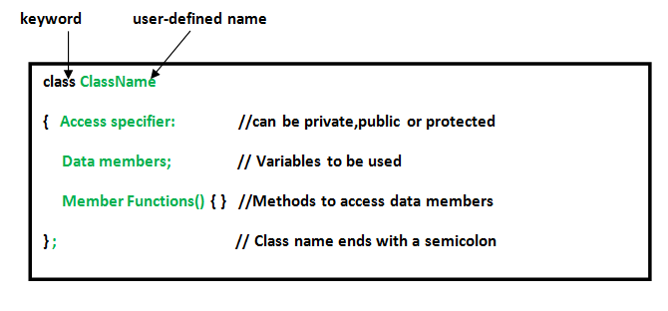

Slide 11
class box
{
Int l, b,h;
Void setDimension(int x,int y,int z)
{……}
Void showDimension()
{……}
};
box b1;

Slide 12
What does a class in C++ holds?
a) data
b) functions
c) both data & functions
d) arrays

Slide 13
How many specifiers are present in access specifiers in class?
a) 1
b) 2
c) 3
d) 4

Slide 14
Which of the following is a valid class declaration?
a) class A { int x; void add(){…} };
b) class B { }
c) public class A { }
d) object A { int x; };

Slide 15
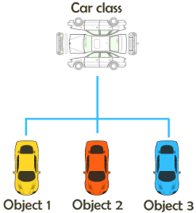
2.OBJECT
OBJECT
An Object is an identifiable entity with some characteristics and behaviour.
An Object is an instance of a Class.
When a class is defined, no memory is allocated but when it is instantiated (i.e. an object is created) memory is allocated.
We can say that a Class in C++ is a blue-print representing a group of objects
which shares some common properties and behaviours.
Object take up space in memory and have an associated address
like a structure or union in C.
NOTE: We will learn the syntax and method for creating class and object in the next chapter.
Figure 1.2 Class and Object [1]

Slide 16
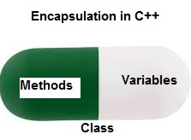
3.ENCAPSULATION
ENCAPSULATION
In normal terms, Encapsulation is defined as wrapping up of data and information under a single unit.
In Object-Oriented Programming, Encapsulation is defined as binding together the data and the functions that manipulate them.
Encapsulation also leads to data abstraction or hiding as using encapsulation also hides the data.
Figure 1.3 Encapsulation [2]

Slide 17
4.ABSTRACTION
ABSTRACTION
Abstraction means creating classes with appropriate functionality and hiding unnecessary details.
Data abstraction refers to providing only essential information about the data to the outside world, hiding the background details or implementation.
Abstraction in Header files:
One more type of abstraction in C++ can be header files.
For example, consider the pow() method present in math.h header file. Whenever we need to calculate the power of a number, we simply call the function pow() present in the math.h header file and pass the numbers as arguments without knowing the underlying algorithm according to which the function is actually calculating the power of numbers.
Abstraction using Classes:
We can implement Abstraction in C++ using classes. The class helps us to group data members and member functions using available access specifiers. A Class can decide which data member will be visible to the outside world and which is not.
NOTE: In C++, we use access labels to define abstract interface to the class. A class may contain zero or more access labels.

Slide 18
5. POLYMORPHISM
POLYMORPHISM
The word polymorphism means having many forms.
In simple words, we can define polymorphism as the ability of a message to be displayed in more than one form.
An operation may exhibit different behaviours in different instances. The behaviour depends upon the types of data used in the operation.
C++ supports operator overloading and function overloading.
Operator Overloading: The process of making an operator to exhibit different behaviours in different instances is known as operator overloading.
Function Overloading: Function overloading is using a single function name to perform different types of tasks.
Polymorphism is extensively used in implementing inheritance.

Slide 19
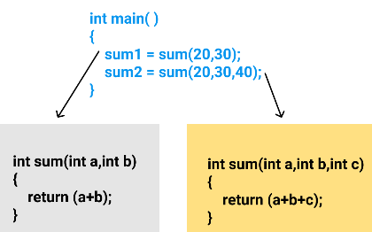
5. POLYMORPHISM(continued..)
POLYMORPHISM
Example: Suppose we have to write a function to add some integers, some times there are 2 integers, some times there are 3 integers. We can write the Addition Method with the same name having different parameters, the concerned method will be called according to parameters.
Figure 1.4 Polymorphism [2]

Slide 20
6.INHERITANCE
INHERITANCE
The capability of a class to derive properties and characteristics from another class is called Inheritance.
Inheritance is one of the most important features of Object-Oriented Programming.
Sub Class: The class that inherits properties from another class is called Sub class or Derived Class.
Super Class: The class whose properties are inherited by sub class is called Base Class or Super class.
Reusability: Inheritance supports the concept of “reusability”, i.e. when we want to create a new class and there is already a class that includes some of the code that we want, we can derive our new class from the existing class. By doing this, we are reusing the fields and methods of the existing class.

Slide 21
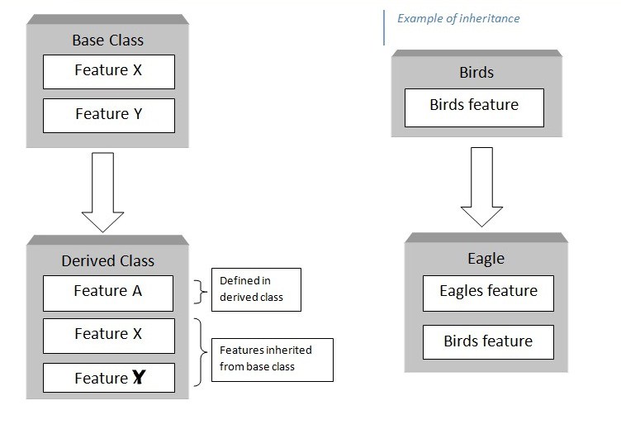
6.INHERITANCE
INHERITANCE EXAMPLE
Figure 1.5 Inheritance [2]

Slide 22
8. MESSAGE PASSING
MESSAGE PASSING
Objects communicate with one another by sending and receiving information to each other.
A message for an object is a request for execution of a procedure and therefore will invoke a function in the receiving object that generates the desired results.
Message passing involves specifying the name of the object, the name of the function and the information to be sent.
It is achieved by passing object as an argument to a function and returning object from a function. We will be covering this topic in the upcoming lectures.

Slide 23
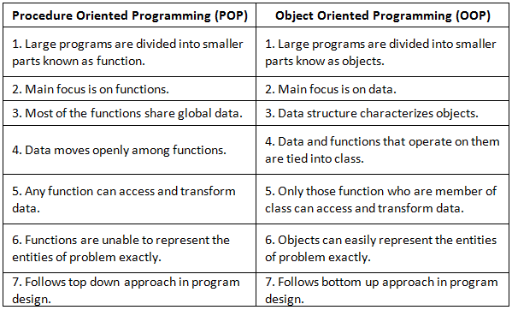
OOP v/s POP
Figure 1.7 OOP vs POP [3]

Slide 24
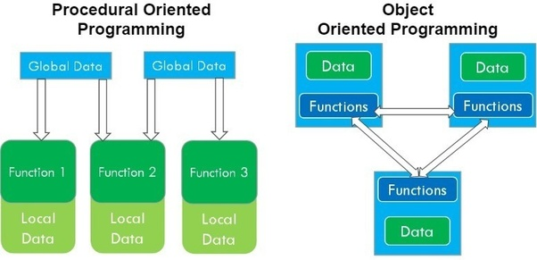
OOP v/s POP
Figure 1.8 OOP vs POP [3]

Slide 25
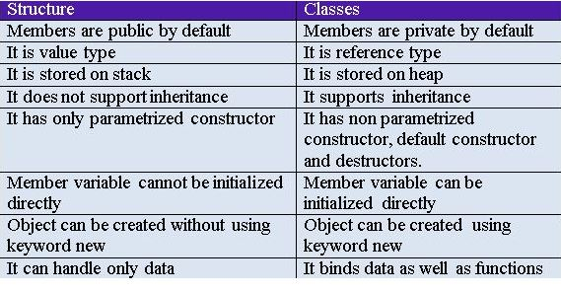
STRUCTURE V/S CLASS
Figure 1.9 Structure vs Class [3]

Slide 26
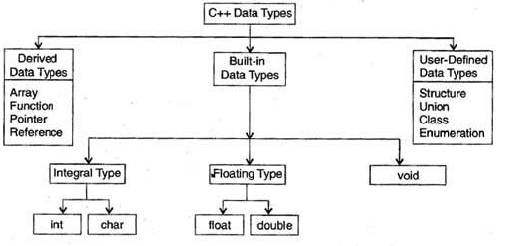
DATA TYPES
Figure 1.10 Data types [3]

Slide 27
DATA TYPE MODIFIERS
A modifier is used to alter the meaning of the base type so that it more precisely fits the needs of various situations.
The modifiers signed, unsigned, long, and short can be applied to integer base types.
In addition, signed and unsigned can be applied to char, and long can be applied to double.
Figure 1.10 Data types [3]

Slide 28
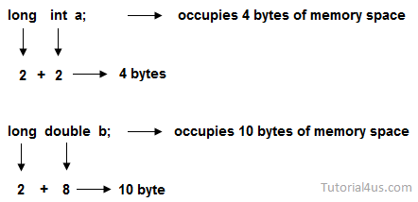
DATA TYPE MODIFIERS
Example- long
This can be used to increased size of the current data type to 2 more bytes, which can be applied on int or double data types.
Figure 1.11 Data types [3]

Slide 29
INPUT AND OUTPUT STREAMS
In C++ there are number of stream classes for defining various streams related with files and for doing input-output operations. All these classes are defined in the file iostream.h
The ios class: The ios class is responsible for providing all input and output facilities to all other stream classes.
The istream class: This class is responsible for handling input stream. It provides number of function for handling chars, strings and objects such as get, getline, read, ignore, putback etc..
The ostream class: This class is responsible for handling output stream. It provides number of function for handling chars, strings and objects such as write, put etc..
The iostream: This class is responsible for handling both input and output stream as both istream class and istream class is inherited into it. It provides function of both istream class and istream class for handling chars, strings and objects such as get, getline, read, ignore, putback, put, write etc..

Slide 30
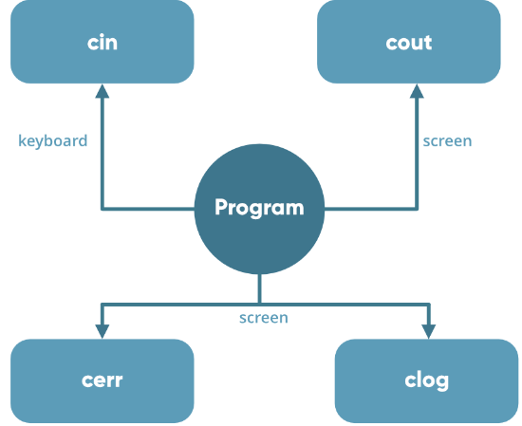
INPUT AND OUTPUT STREAMS
The two keywords cout in C++ and cin in C++ are used very
often for printing outputs and taking inputs respectively.
These two are the most basic methods of taking input and
printing output in C++. To use cin and cout in C++ one must
include the header file iostream in the program.x
Figure 1.13 I/O streams [3]

Slide 31
Standard Output (cout)
By default, the standard output of a program points at the screen. So with the cout operator and the “insertion” operator (<<) you can print a message onto the screen.
Example:
#include<iostream>
using namespace std;
int main()
{
cout << "Hello World!";
return 0;
}

Slide 32
Standard input (cin)
In most cases the standard input device is the keyboard. With the cin and >> operators it is possible to read input from the keyboard.
Example:
#include<iostream>
using namespace std;
int main()
{
char MY_CHAR;
cout << "Press a character and press return: ";
cin >> MY_CHAR;
cout << MY_CHAR;
return 0;
}

Slide 33
Namespace
Namespace is used to define a scope where identifiers like variables, functions, classes, etc are declared. The main purpose of using a namespace is to prevent ambiguity that may occur when two identifiers have same name
A namespace definition begins with the keyword namespace followed by the namespace name as follows −
Syntax:
namespace namespace_name
{ // code declarations }
To call the namespace-enabled version of either function or variable, prepend (::) the namespace name as follows −
name::code; // code could be variable or function.

Slide 34
Namespace
When we use using directive, we import all the names in the namespace and they are available throughout the program, that is they have global scope.
But with using declaration, we import one specific name at a time which is available only inside the current scope.
Example:
namespace X
{
int x;
class Check
{
int i;
};
}

Slide 35
The using directive
using keyword allows you to import an entire namespace into your program with a global scope. It can be used to import a namespace into another namespace or any program.
This directive tells the compiler that the subsequent code is making use of names in the specified namespace. The namespace is thus implied for the following code −
#include <iostream>
using namespace std;
namespace first_space
{
void func()
{
cout << "Inside first_space" << endl;
}
}
using namespace first_space;
int main ()
{
// This calls function from first name space.
func();
return 0;
}

Slide 36
Assessment Pattern
Section-A
(a) How structure is different from class
(b) Explain the use of cout and cin with examples.
(c) What are insertion and extraction operators?
Section-B
Differentiate between POP and OOP.
Explain features of OOP language.
What is namespace? Write a program to create your own namespace.

Slide 37
APPLICATIONS
Client- server systems
Neural networking
Parallel Programming
Object oriented databases
AI Expert systems

Slide 38

REFERENCES
Reference Website
[1] https://en.wikipedia.org/wiki/Object-oriented_programming
[2] https://www.geeksforgeeks.org/object-oriented-programming-in-cpp/
[3] https://tekslate.com/static-dynamic-binding-virtual-function-c-language

Slide 39
THANK YOU
For queries
Email: CST_2019@gmail.com

